Slide 1
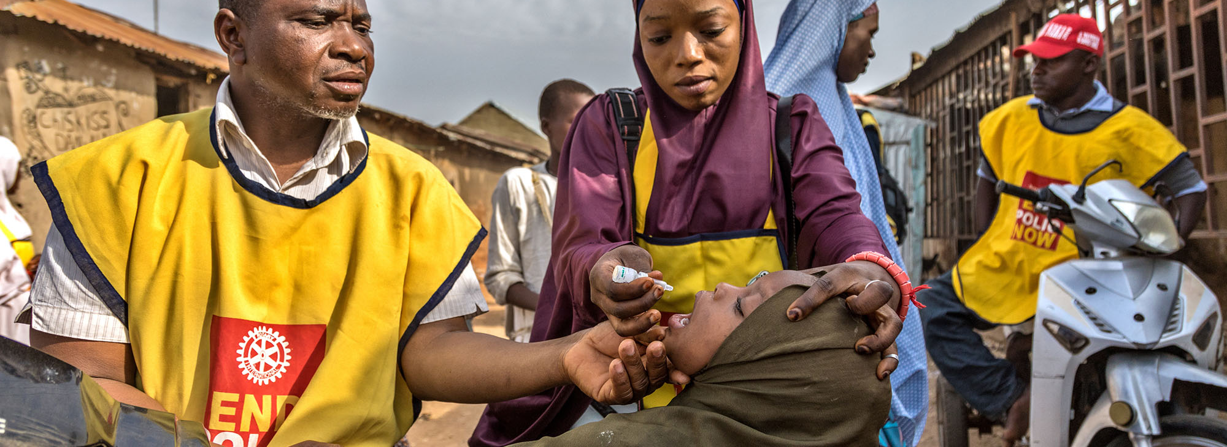
Bringing Rotary’s BRAND Strategy and Story to Life
July 22, 2022

Slide 2
SINCE 2011, AWARENESS IS IMPROVING
GLOBAL AWARENESS
3
4
out of
people have heard of Rotary
Source: 2015 Rotary Public Image Survey, Leger (February 17, 2016)
Notes:
Back in 2011, Rotary International conducted a major worldwide research project to measure the level of knowledge and understanding the general public had about Rotary. At that time, 4 in 10 people had never heard of Rotary. As a result, Rotary International launched new branding and messaging, including a new logo, brand identity system, and a branding portal for Rotarians around the world to access materials, guidelines, and templates.
Rotary conducted a follow-up study in 2015. The good news is that we increased the level of awareness for Rotary to 75%. Great news, in fact, right?

Slide 3
BUT WE NEED TO INCREASE UNDERSTANING
FAMILIARITY WITH LOCAL ROTARY CLUBS
Source: Six Country Omnibus Research, Leger (May 2018)
Notes:
Unfortunately, despite the increase in awareness, the understanding of Rotary remained low at 35%. In fact, 60% of the respondents were unfamiliar with a local Rotary club or project. That’s where the action happens and provides the greatest opportunity for public engagement. People don’t realize that they can make a difference in their own backyard.
Also, the public lacks a clear understanding or Rotary, our projects, and our impact. A third of the global respondents were unfamiliar with ANY Rotary program, including our signature End Polio Now program.

Slide 4

OUR BRAND PERCEPTION(S)
Notes:
And how do others see us? We regularly conduct research around the world with the general public, to assess what they know and think about Rotary. And while the responses vary from market to market, on thing remains the same – whiles some of the descriptions are accurate, there are a lot of misperceptions about our brand. In fact, many people respond “don’t know” when asked What comes to mind when you hear the name Rotary or Rotary Club? Having a consistent and relevant way to talk about Rotary is critical in establishing a correct and positive impression and increasing understanding of our organization.

Slide 5
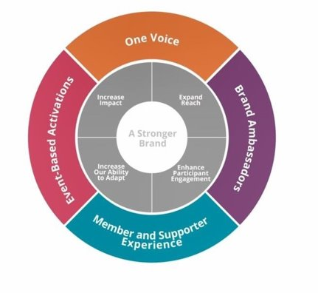
COMMUNICATIONS PRIORITIES ALIGN WITH ACTION PLAN PRIORITIES
Eradicate polio and leverage
the legacy
Focus our programs and offerings
Improve our ability to achieve
and measure impact
Eradicate polio and leverage
the legacy
Focus our programs and offerings
Improve our ability to achieve
and measure impact
Grow and diversify our membership and participation
Create new channels into Rotary
Increase Rotary’s openness
and appeal
Build awareness of our impact
and brand
Grow and diversify our membership and participation
Create new channels into Rotary
Increase Rotary’s openness
and appeal
Build awareness of our impact
and brand
Increase
Impact
Expand
Reach
Increase
Impact
Expand
Reach
Build a culture of research, innovation and willingness
to take risks
Streamline governance,
structure and processes
Review governance to foster
more diverse perspectives
in decision-making
Support clubs to better engage
their members
Develop a participant-centered approach to deliver value
Offer new opportunities for personal and professional connection
Provide leadership development
and skills training
Support clubs to better engage
their members
Develop a participant-centered approach to deliver value
Offer new opportunities for personal and professional connection
Provide leadership development
and skills training
Increase
Our Ability
to Adapt
Increase
Our Ability
to Adapt
Enhance Participant Engagement
Enhance Participant Engagement
Notes:
Marketing challenge: how do we bring together the need to increase understanding with the need to help the organization achieve it’s strategic priorities?

Slide 6
1
  ONE VOICE
Elevate a consistent identity, voice and message
Notes:
HOW WE INCREASE REACH – MAKE SURE EVERYONE WE HAVE UNIFIED AND CONSISTENT REPRESENTATION OF WHO WE ARE AND WHAT WE DO
Presidents can make brand a priority. Membership, service important and they can be enhanced by focus on brand.
Devote meeting. Appoint a public image/brand chair and have a team dedicated to this. Job description on Brand Center.
Through a consistent brand, communicated to the public by all of us, we can:
increase community and member involvement in our service projects and fundraisers
strengthen our existing club through member engagement
increase our club’s membership by attracting new members
and grow new clubs

Slide 7

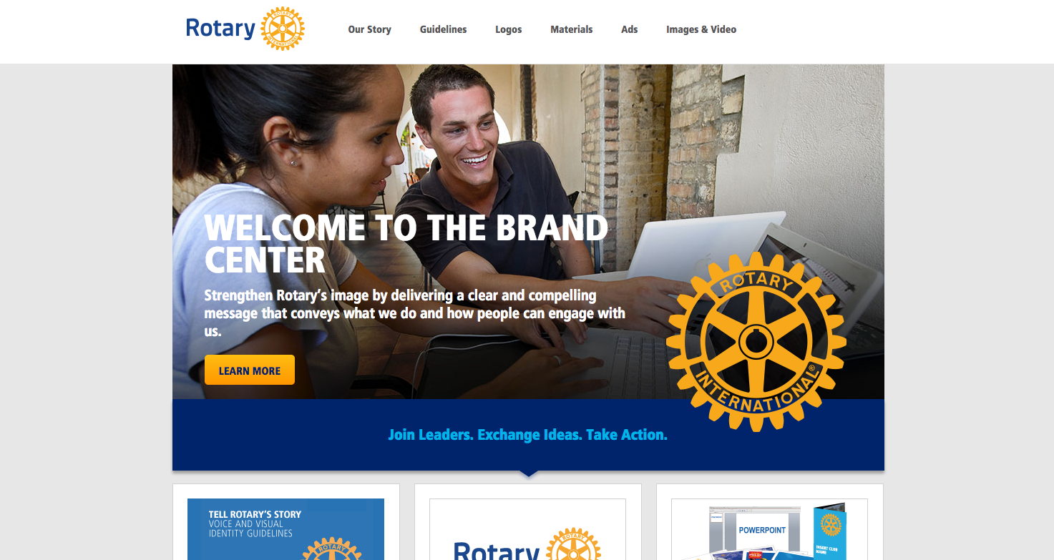
ROTARY.ORG/
BRANDCENTER
Notes:
The first step is to go into Rotary’s brand portal, called Brand Center.
You can access it directly at rotary.org/brandcenter or from My Rotary through the Manage pull-down tab. In either way, you will need to login with your rotary.org credentials.
Brand Center is the one-stop shop where you can find materials to bring your club’s public image to life, using the Rotary brand.
Brand Center has a variety of tools, including:
Guidelines
Logos
Templates and other customizable materials
Flyers and brochures
And press releases, ads, and videos
If you are not familiar with Brand Center, I recommend that you log on and explore it to familiarize yourself with all of its materials. You’ll be amazed at what you can do.
The first step is to go into Rotary’s brand portal, called Brand Center.
You can access it directly at rotary.org/brandcenter or from My Rotary through the Manage pull-down tab. In either way, you will need to login with your rotary.org credentials.
Brand Center is the one-stop shop where you can find materials to bring your club’s public image to life, using the Rotary brand.
Brand Center has a variety of tools, including:
Guidelines
Logos
Templates and other customizable materials
Flyers and brochures
And press releases, ads, and videos

Slide 8
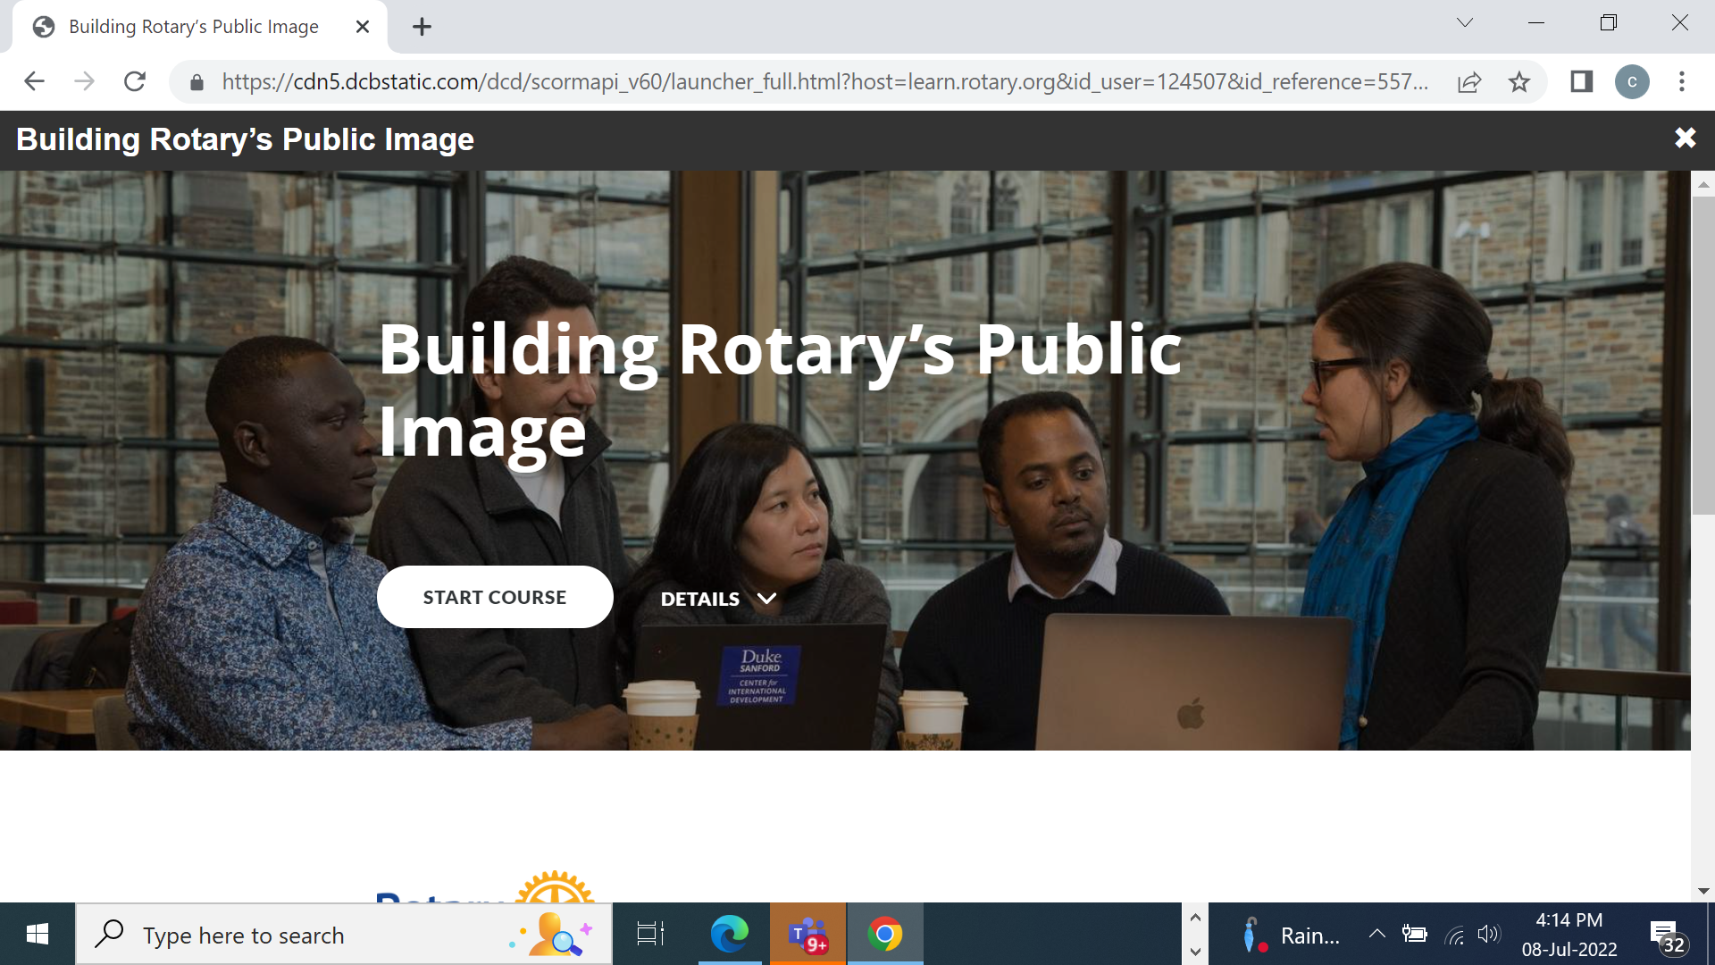
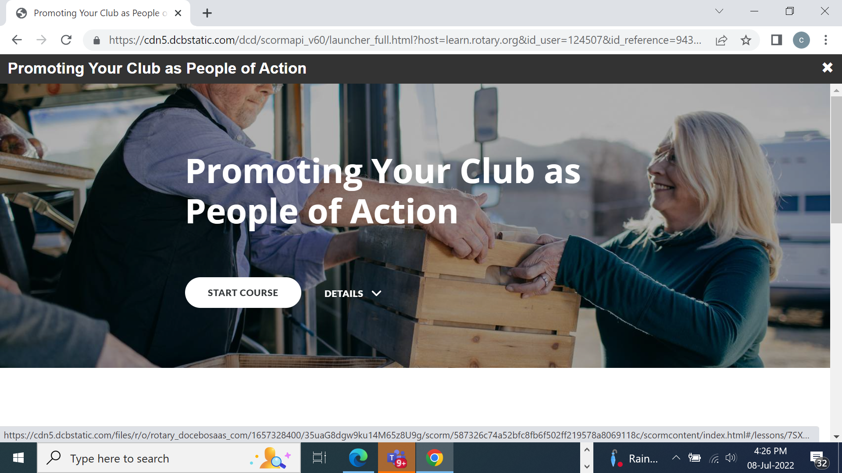
THE LEARNING CENTER
Notes:
In addition to the Brand Center, I also recommend going to the Learning Center, available from My Rotary. The Learning Center has a variety of courses you can take, including new courses on the Rotary Brand and Building Rotary’s Public Image. These two courses are only 15 minutes long, and you can take them at your own convenience.

Slide 9







FOCUS ON BRAND FIDELITY
ROTARY CLUBS
ROTARY INTERNATIONAL
THE ROTARY FOUNDATION
ROTARACT CLUBS
INTERACT CLUBS

Slide 10
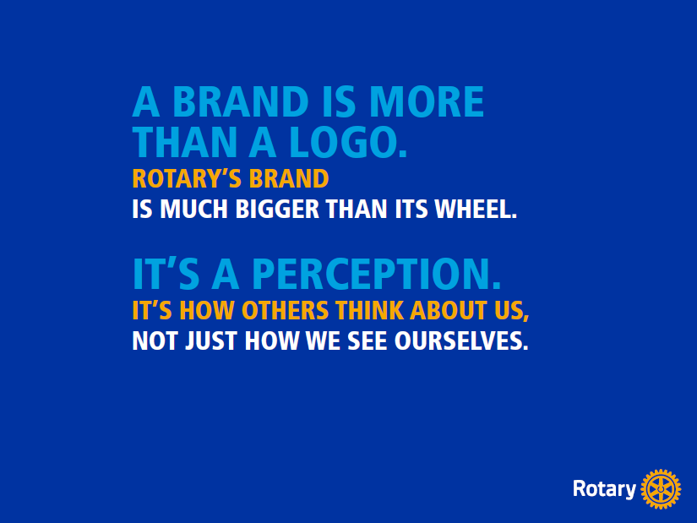
Public image (noun): the perception or opinion others have of you
Rotary’s public image isn’t just what we think of ourselves –
It’s what people outside of Rotary think of us

Slide 11


2
  BRAND AMBASSADORS
1.4 MILLION
STORIES TO TELL
Empower and encourage members to share their own impact stories
Notes:
1.4 million brand ambassadors
PEOPLE RESPOND AND CONNECT TO STORIES. Presidents can stress how important it is for people to tell a story about what Rotary means to them. Recognize that different people are motivated by different things. Stress importance of encouraging members to share with the group what they personally get from Rotary. Good way to cross pollinate stories AND have a more open dialogue about what the club is doing well to engage existing members.
.
And we have great stories to tell! I’m a firm believer that when we tell our stories in a
way that recognizes many different people, we will change the “face” of Rotary to
become more welcoming, more vibrant, and more relevant

Slide 12

PEOPLE OF ACTION
1.4 MILLION
Notes:
How we talk about ourselves
It Answers:
What is Rotary?
Who are Rotarians?
What’s our impact?
How are we different?
A messaging platform and set of resources that works across multiple platforms
Press Release and Website Stories
Facebook
Outdoor Advertising
Print Ads
TV and Radio

Slide 13
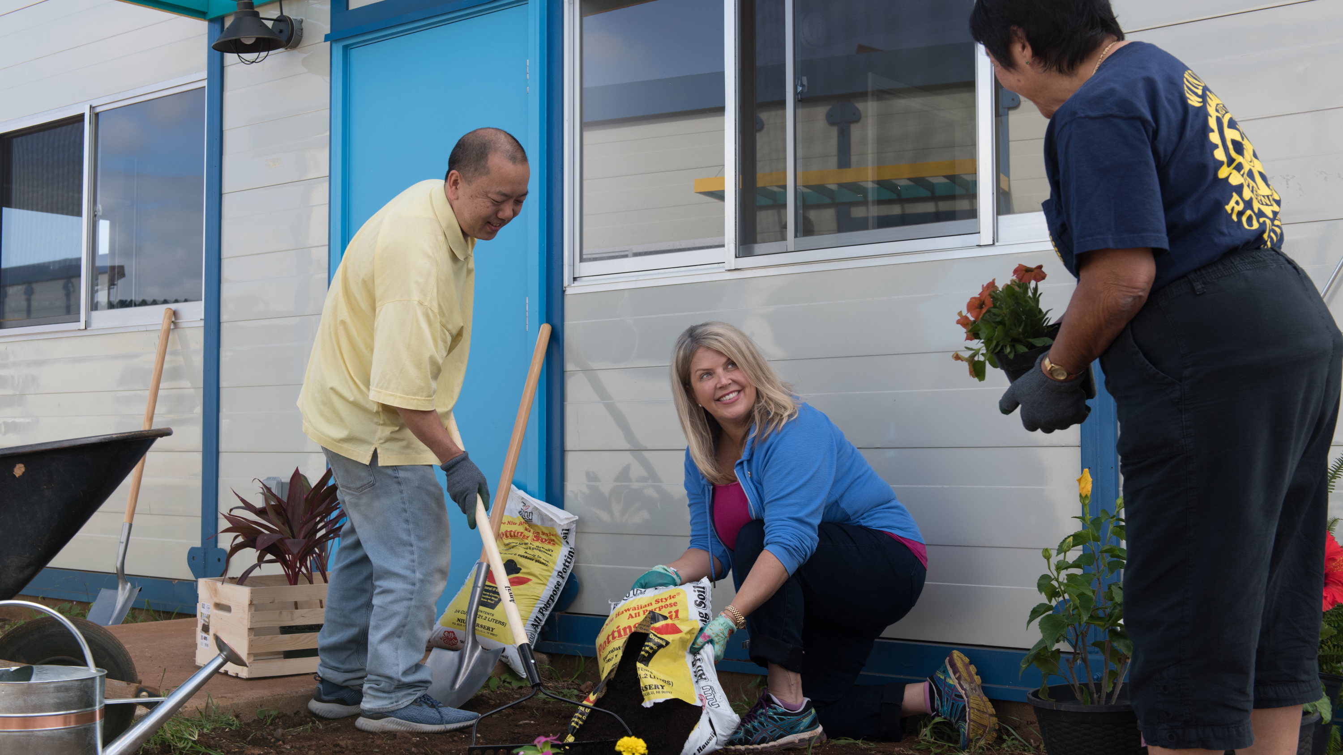
People of action
More than an advertising campaign
Shows members as People of Action
Narrows the gap between awareness and understanding
Consistent framework to tell our stories
Relies on members sharing stories with the public
Notes:
People of Action - our positioning and messaging platform aimed at external audiences to raise the public image of Rotary. It showcases members taking action to make a difference in their communities, and provides a consistent, current way to describe Rotary to those who don’t know us.

Slide 14
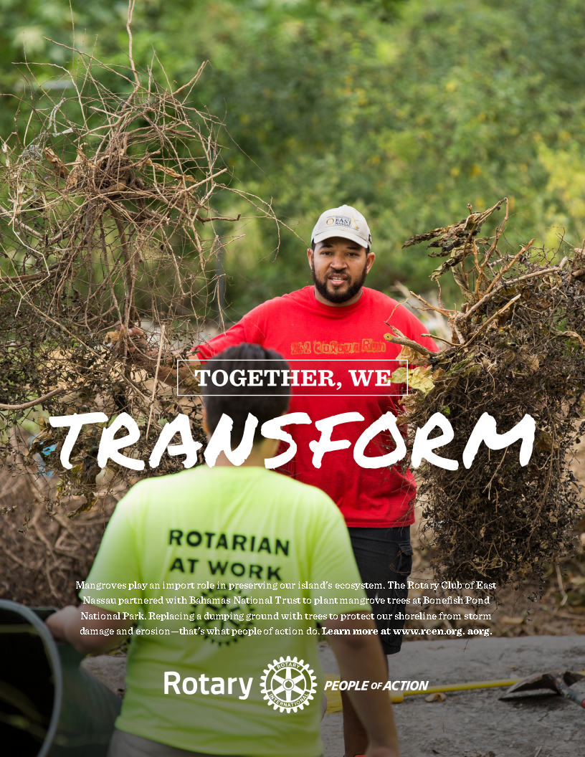
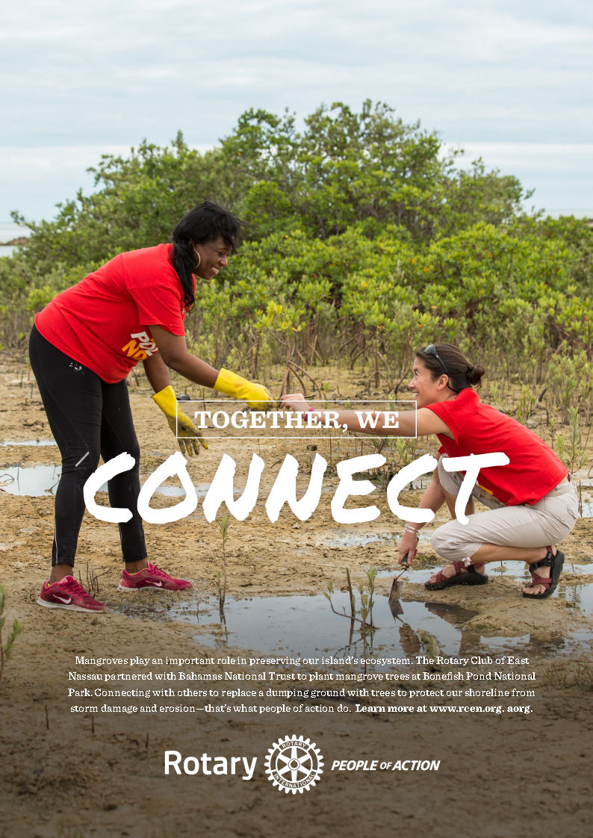
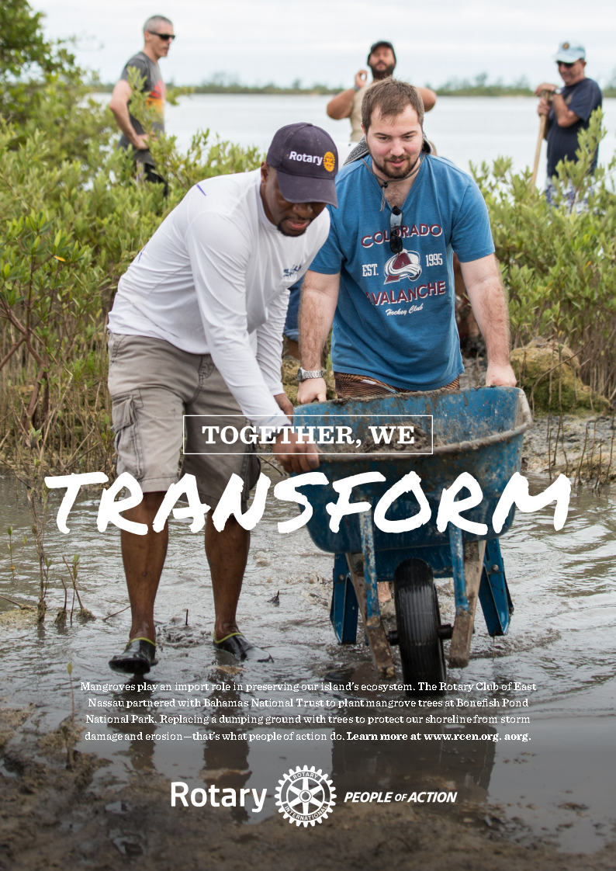
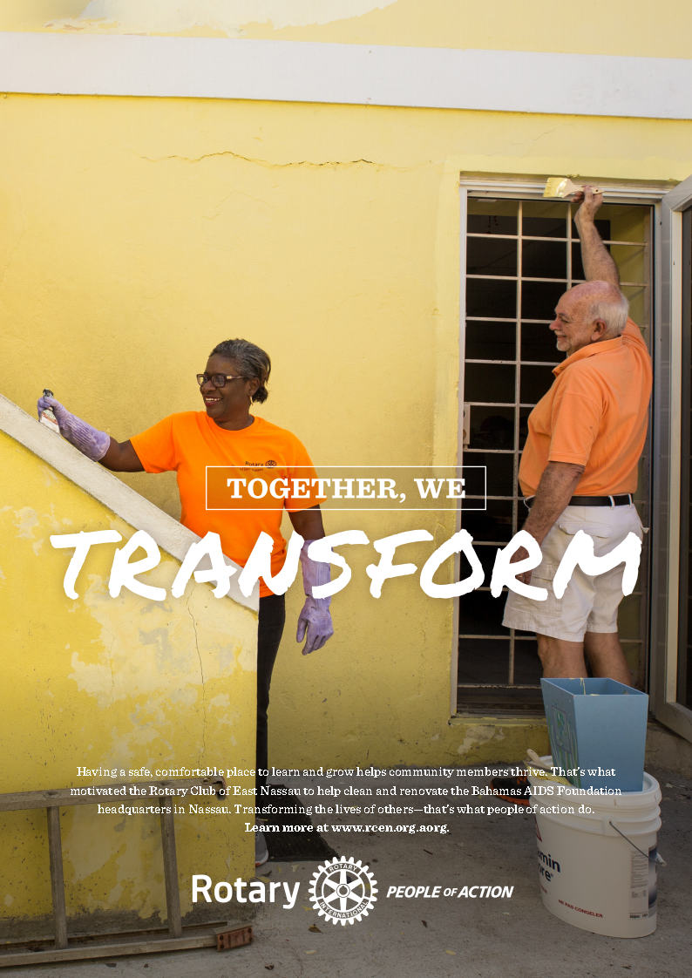
YOUR STORY IS ROTARY’S STORY: Join the Campaign

Slide 15
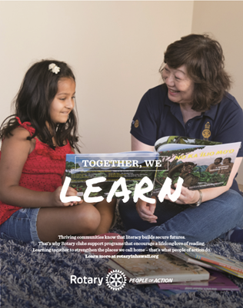

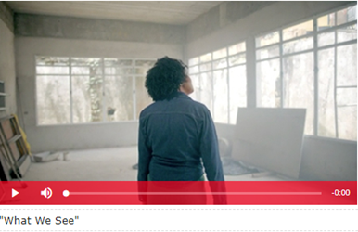

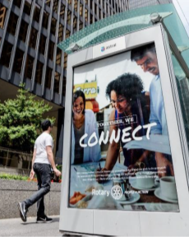

social media graphics
video ads
print ads
radio ads
transit ads
photo tips

Slide 17
3
  MEMBER AND
  SUPPORTER EXPERIENCE
Encourage clubs to enhance and
promote their experiences to the public

Slide 18
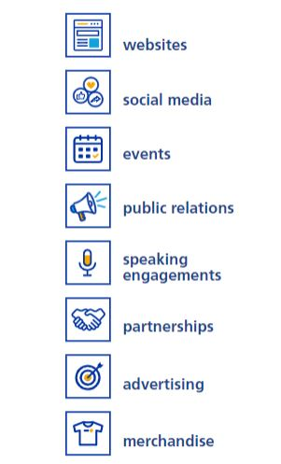
Ways to Promote rotary
Notes:
Armed with knowledge and resources from BC and TLC, now it’s time to go public with our messaging: we have to There are many ways to communicate Rotary’s impact. All of them are effective, and are especially impactful when they build upon each other. Telling stories of local impact consistently across communication channels will help build Rotary’s public image.

Slide 19
4
  EVENT-BASED ACTIVATIONS
Engage and energize our communities through signature events

Slide 20

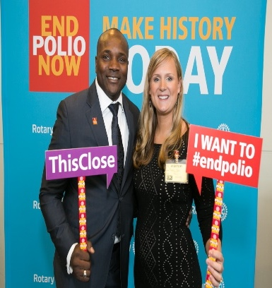

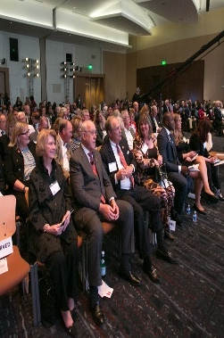

WORLD POLIO DAY
World Polio Day is everywhere
Global status update
Early distribution of WPD toolkit – includes “how-to” for event
Gathering WPD content starting NOW

Slide 21

UNDERSCORE THE IMPORTANCE OF STRENGTHENING ROTARY AT PETS
Lead by example
  Branding your event
  Use People of Action imagery
Invite speakers with advertising and communications industry experience
Notes:
HOW TO MAKE SURE PETS TRAININGS MODEL WHAT WE WANT PRESIDENTS TO DO

Slide 22
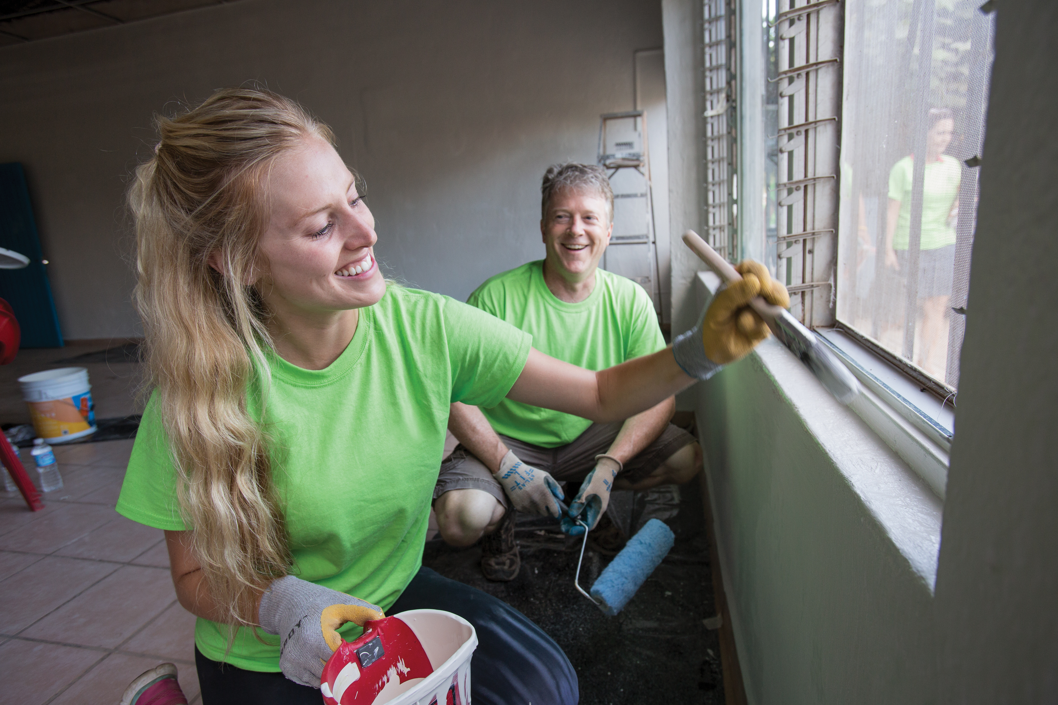
WHAT PRESIDENTS CAN DO TO HELP
STRENGTHEN ROTARY
Appoint a public image chair
Assess club’s brand & brand fidelity
Use Brand Center/Learning Center
Build Upon People of Action messaging; PSA campaign
Participate in World Polio Day

